Slide 1

Digital Citizenship 101
Middle School/High School
2018-2019
Notes:
Welcome to Digital Citizenship 101
Introduce yourself and verify that students all have a copy of the note taker and have some colored pencils or highlighters to doodle with.

Slide 2

Who Should Be Here?
Notes:
Any TUSD student who is receiving and accessing an Office 365 through the district. This training is mandatory and should be taken seriously. There will have a quiz at the end of this training that students are required to take and will need to get 100% in order to receive their O365 account. They will be able to use their note taker while doing this quiz, so it is important that they are filling in the information as we go along.

Slide 3

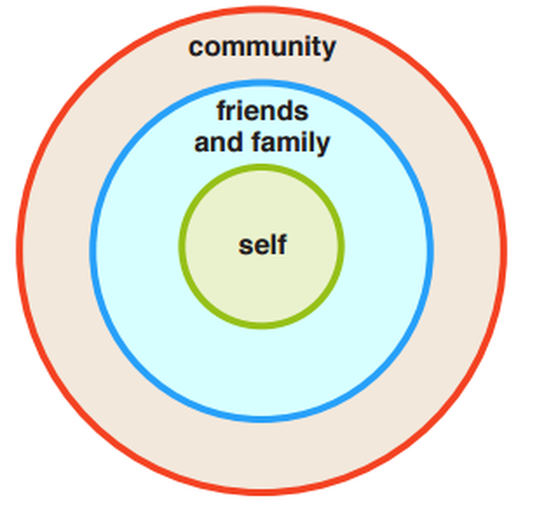

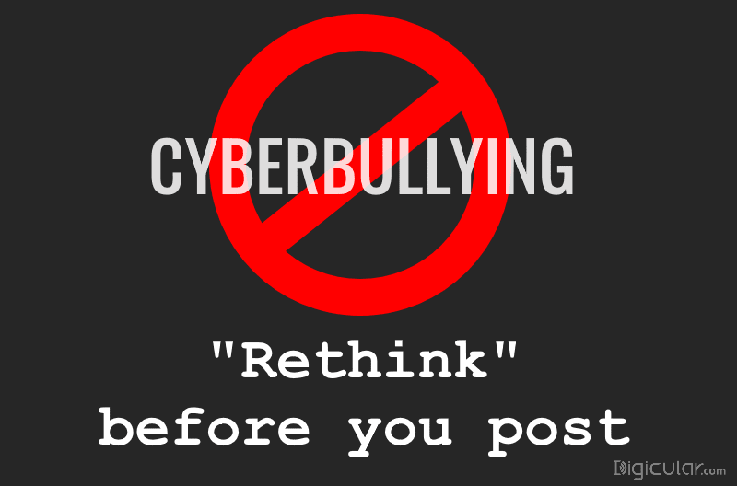
Agenda
Digital Citizenship
Online Safety
Online Best Practices
Cyberbullying
Behaving Respectfully
Digital Footprint
Your Responsibility
Digital Citizenship Pledge
Source: http://www.edudemic.com/teachers-guide-digital-citizenship/
Source: http://www.edudemic.com/7-tips-successful-online-student/
Notes:
Here is what will be covered in the training

Slide 4
What is Digital Citizenship?
Let's watch this video
Source: https://www.commonsensemedia.org/videos/what-is-digital-citizenship
Notes:
What is digital citizenship?
https://www.commonsensemedia.org/videos/what-is-digital-citizenship
Watch and discuss (40 second video)

Slide 5

Online Safety
Being online = amazing connections
Being online = great collaboration
Being online = 24/7 access
Being online = predators
Notes:
Being online and using O365 provides great opportunities to connect with people everywhere, allows you to work on projects in teams, and gives you 24/7 access to your apps and files from any device anywhere.
But the downside is it opens you up to inappropriate content, inappropriate information, and online predators.

Slide 6
Online Safety: Predators
Online Predators are defined as individuals who participate or engage in predatory, exploitative behavior through an online presence. In many cases, Online Predators utilize computational networking systems in the form of the Internet to take advantage of or prey upon their victims.
Source: https://cyber.laws.com/computer-crime/online-predators
Notes:
Let’s define “predators”.
How do you know that the person you’re chatting with is really who they say they are?
Gamers, be careful. Gamers come in all shapes and sizes. With the ability to chat/play online around the world, you need to be cautious.

Slide 7
Online Safety: Inappropriate Content
Adult Activities
Violence
Hate Speech
Risky or illegal behaviors
This type of content is not appropriate or professional for the classroom setting.
Source: https://www.netsmartz.org/Home
Notes:
Seeing things you don’t want to see or shouldn’t see is one of those risks.
Inappropriate content includes:
Adult activities.
Violence.
Hate speech.
Risky or illegal things like dangerous stunts or drinking games.
It may seem cool to look up this type of content, but is not appropriate or professional for the classroom setting.

Slide 8
Online Safety: Inappropriate Information
Information that you shouldn’t share online includes:
Embarrassing things about you or other people
Revealing pictures
Pranks
Illegal behavior
Hate Speech
Possible Consequences for posting these things online:​
Could hurt your reputation or impact your future college and career plans.
Could get in trouble at home, at school or even by the law.​
Could lead to loss of privileges and or disciplinary action. ​
​
Source: https://www.netsmartz.org/Home
Notes:
Inappropriate information that you shouldn’t share online includes:
Embarrassing things about you or other people.
Revealing pictures.
Pranks.
Illegal behavior (drugs, alcohol, etc.).
Hate speech.
Posting these things online means you may:
Get a bad reputation.
Be punished at home, at school or even by the law.
Hurt your chances of getting into college or getting a job in the future.
And could lead to loss of privileges and or disciplinary action.

Slide 9
Online Safety: What to Do
Report it to an adult immediately
Take Screenshot, if instructed
Minimize screen if you need to show it to an adult
Close or delete it if you don't need to report it.
Source: https://www.netsmartz.org/Home
Notes:
First and foremost, any inappropriate behavior should be reported immediately to an adult (teacher/ administrator)
Take a screenshot if you can and if it will help with any investigation
Minimize the screen if you need to show an adult. Close or delete it if you do not. Example: Close a window if an inappropriate ad pops up (Example: CoolMath ads)

Slide 10
Online Safety: Best Practices
Don’t share usernames and passwords
Don’t share personal information
Use privacy settings and check them often
Choose appropriate screennames
Only accept friend request from and communicate with people you know in real life
Don’t make jokes that are threats
Source: https://www.netsmartz.org/Home
Notes:
Don’t share personal information - Remember, that includes your address, phone numbers, usernames, passwords and schedule. DO NOT share your phone password or your TUSD username/password! Today you’re BFFs. Tomorrow you are mortal enemies because you like the same boy.
Use privacy settings and check them often - That means setting your page to private and limiting who can see your posts and pictures.
Choose appropriate screennames - You don’t want to give the wrong impression, so pick something that’s not embarrassing or offensive.
Only accept friends you know in real life - That goes for “friends of friends,” too. If you don’t know them, don’t add them!
Don’t make jokes that are threats - They can be taken out of context and you can get in serious trouble. Example: you don’t joke about guns.

Slide 11
Respect Online: Cyberbullying
What is it?
Using the internet or electronic means to make another person feel angry, sad, or scared.
It is something that is done repeatedly.
TUSD can intervene with a situation on social media (private accounts) if it affects the victim's ability to feel safe in the educational environment.​
Source: http://bit.ly/2JIDsPX
Notes:
Bulllying is defined as repeated, intentional unwanted aggression. It can be physical. I can be verbal. It can face-to-face. It can be online.
TUSD can intervene with a situation on social media (private accounts) if it affects the victims ability to feel safe in the educational environment.

Slide 12
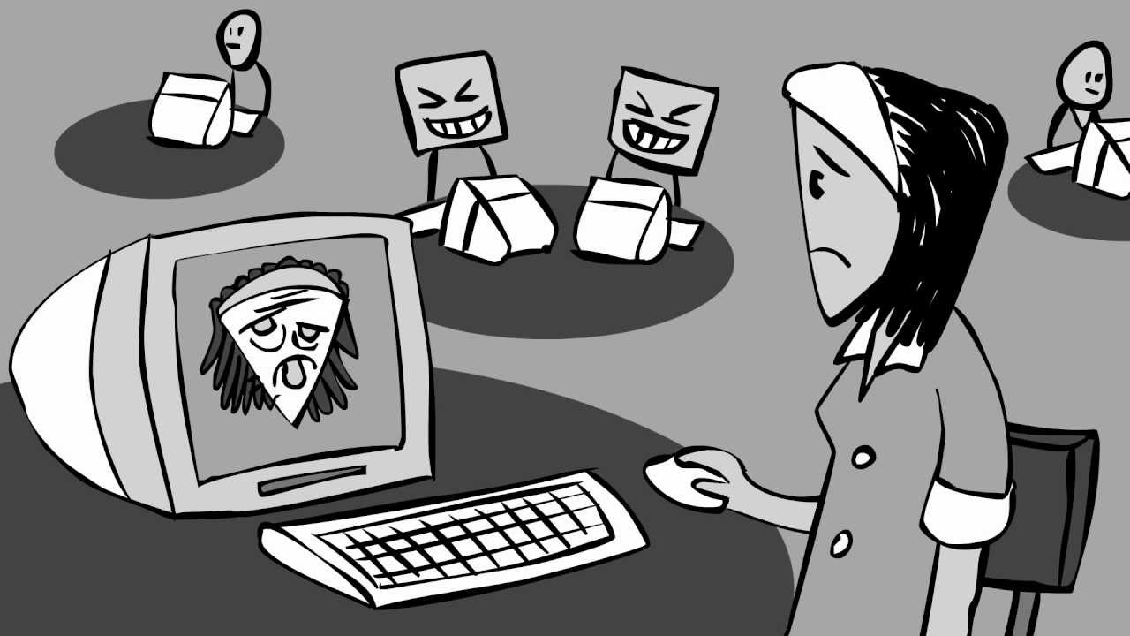
Respect Online: Cyberbullying
If you see it happening:
  Show support
  Refuse to join in
  Report it to an adult
If you don’t like someone:
Ignore them when you can
Be professional and courteous
Source: https://www.netsmartz.org/Home
Notes:
Remind students to fill in their note taker.

Slide 13
Behaving Respectfully When Online
Your online behavior and actions have enormous consequences.
Possible Consequences for Behaving Disrespectfully:​​
Cause others to feel hurt.
Impact future professional opportunities.
Legal consequences.
Could impact your child's future opportunities.
Remember, your kids are watching.
Lead by example!
Source: http://bit.ly/2LM1TfX
Notes:
Students need to understand that their actions, even those taken online and behind multiple computer screens, can and do have enormous consequences.
The emotional results of behaving disrespectfully online are arguably the most important thing to stress here, but there can be professional and legal consequences for bad online behavior as well. If you say hurtful things on social media that future potential employers (or friends, for that matter) can see, it will have long-term effects on what people think about you and may impact the opportunities you have.

Slide 14
Digital Footprint
Definition:
One's unique set of digital activities, actions, and communications that leave a data trace on the internet or on a computer (or other digital device) and can identify that particular user or that particular device.
Source: http://www.dictionary.com/browse/digital-footprint
Notes:
This most important thing to remember is that once you post something online, you can’t take it back
And just because you’ve deleted something doesn’t mean it’s gone.
Again what you do online matters. You could:
Get a bad reputation.
Be punished at home, at school or even by the law.
Hurt your chances of getting into college or getting a job in the future.
And could lead to loss of privileges and or disciplinary action.

Slide 15

Digital Footprint
Once you post it, you can’t un-post it
Respect yourself. Respect Others
Oversharing: Think Before You Post Online
Source: https://www.netsmartz.org/Home
Notes:
Be respectful online means keeping your dignity, being professional, and being a decent human being. We want that for everyone.
Once you post it online, it can’t be undone. Deleting does not mean it’s truly gone.
Show video (~3.5 minutes)
https://www.commonsense.org/education/videos/oversharing-think-before-you-post

Slide 16
Rings of Responsibility
Responsibility: An obligation or duty you have to yourself or others
Community: A group of people with common background or shared interests
Digital Citizen: A member of a worldwide community linked by the Internet
Source: https://tusd.learning.powerschool.com/tusdconnect/digitalcitizenship/cms_page/view/15241329
Notes:
Read and discuss – remind students to add information to their note taker.

Slide 17
Rings of Responsibility
Self: staying safe and keeping healthy
Family and Friends: helping with chores, listening to them when they have a problem
Community: following rules at school, playing safely on the Internet
Source: https://tusd.learning.powerschool.com/tusdconnect/digitalcitizenship/cms_page/view/15241329
Notes:
Read and discuss
Ask the following statements: Which ring?
I am respectful and kind when communicating online. (Community)
I never reveal my family’s home address. (Family and Friends)
I never participate in online bullying. (Family and Friends)
I visit sites that are safe. (Self)

Slide 18
Digital Citizenship Pledge
Communicate responsibly and kindly with one another.
Protect our own and others’ private information online
Stand up to cyberbullying
Respect each other’s ideas and opinions
Give proper credit when we use others' work
Source: https://www.commonsense.org/education/system/files/uploads/classroom-curriculum/3-5-unit2-digitalcitizenshippledge.pdf?x=1
Notes:
Could have students make posters for these, or refer to their student handbook.
Students will need to sign the acceptable use form and the quiz on this digital citizenship course before getting their O365 accounts.

Slide 19
Images
https://makeawebsitehub.com/social-media-sites/
http://worldartsme.com/diverse-students-clipart.html#gal_post_33003_diverse-students-clipart-1.jpg
https://emojiisland.com/products/smiling-face-emoji-icon
https://www.youtube.com/watch?v=asTti6y39xI
https://digicular.com/rethink-anti-cyber-bullying-app/
https://twitter.com/handsrespect
http://www.homodigital.net/2016/01/post-destacado-blogger.html
http://www.crazy4computers.net/rings-of-responsibility.html
Source: https://www.netsmartz.org/Home

